Slide 1
Android Coding Style
- make coding more effcient
tome.huang@yahoo.com

Slide 2
Catalog
Part 1. Java Code Style
Part 2. Android Programming
Part 3. References & Share
Part 4. Q & A

Slide 3
Part 1. Java Code Style

Slide 4
1. Exceptions
Benefits:
OO feature
Separate work flow and exception handling
Makes code more readable and maintainable

Slide 5
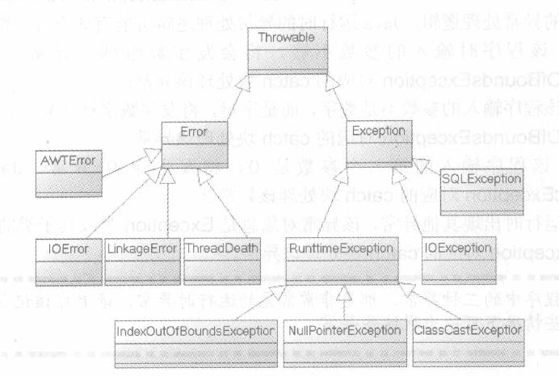
1. Exceptions

Slide 6
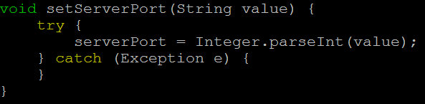
1. Exceptions
E.X
Method ‘setServerPort’:
Configure port number for connection

Slide 7
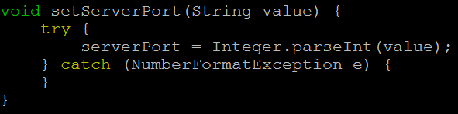
1. Exceptions
ver 2:

Slide 8
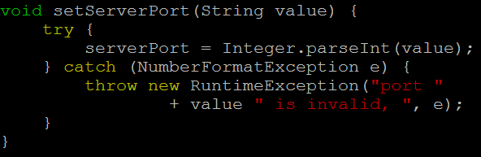
1. Exceptions
ver 3:

Slide 9
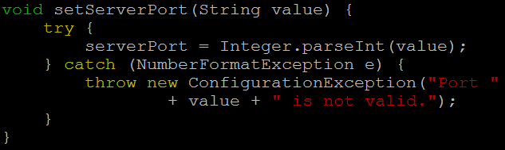
1. Exceptions
ver 4:

Slide 10
1. Exceptions
1.1. Exceptions are friends
1.2. Do not left catch body empty
1.3. Catch the right exceptions
1.4. Throw the appropriate exception

Slide 11
1. Exceptions
Tips: (in a word, accuracy)
Catch each exception separately as separate catch blocks after a single try.
Refactor your code to have more fine-grained error handling, with multiple try blocks.
Rethrow the exception.

Slide 12
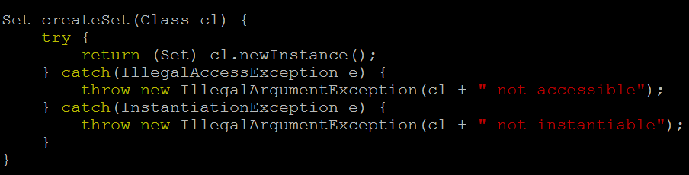
1. Exceptions
Make it like this:

Slide 13
2. Indentation
Use spaces instead of tabs
For code blocks, use 4 spaces
For line wrapping, use 8 spaces

Slide 14
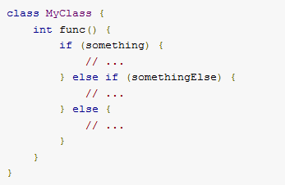
1. Exceptions
Make it like this:

Slide 15
2. Indentation
For ‘if’ statements:
if (condition) {
body();
}
if (condition) body();
if (condition)
body();

Slide 16
2. Indentation
For line length limit:
Line length <100 char
Exceptions:
url
import

Slide 17
3. Comments
Java annotations:
@Deprecated
@Override
@SuppressWarnings

Slide 18
3. Comments
Where are the comments
head of file
head of module (class)
head of method declaration
start of method body
tail of constance declaration
tail of end brace

Slide 19
3. Comments
TODO Comments:
public void onCreate() {
// TODO: init local variables
}

Slide 20
4. Others
Package imports:
import foo.*;
import foo.Bar;

Slide 21
4. Others
String compare:
boolean isEmpty(String str) {
if (str.equals(“”) /* str.isEmpty() */) {
return true;
}
return false;
}

Slide 22
4. Others
String compare:
boolean isEmpty(String str) {
if ("".equals(str)) {
// CONST_STR.equals(str)
return true;
}
return false;
}

Slide 23
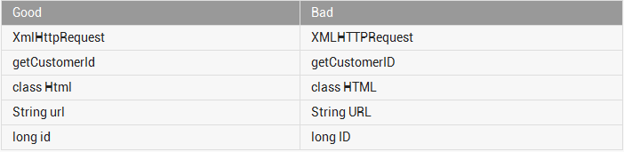
4. Others
Name acronyms as words:

Slide 24
4. Summary
Be consistent
Be efficient
Be accurate

Slide 25
Part 2. Android Programming

Slide 26
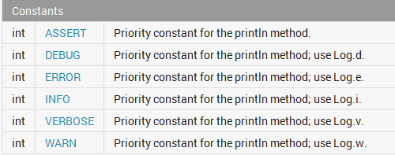
1. Log Sparingly
Log Levels in logcat

Slide 27
1. Log Sparingly
•ERROR: be used when something fatal has happened
•WARNING: something serious and unexpected happened
•INFORMATIVE: note that something interesting to most people happened
•DEBUG:be relevant to investigate and debug unexpected behaviors
•VERBOSE:everything else

Slide 28
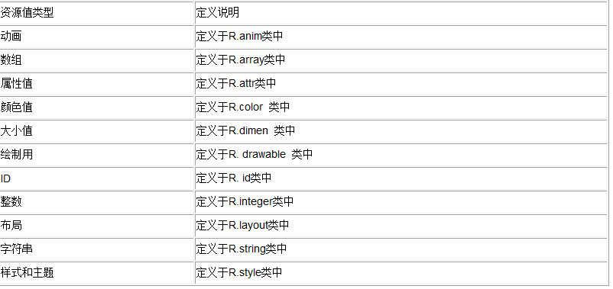
2. XML files
Put resource definition into right xml file:

Slide 29
3. Permissions
Generate appropriate permissions for APK

Slide 30
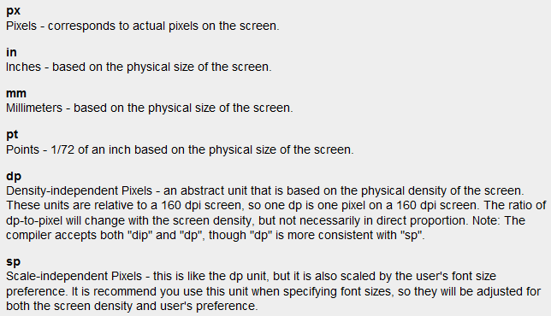
4. Dimension units

Slide 31
4. Dimension units
For more information, check
http://developer.android.com/guide/topics/resources/more-resources.html#Dimension

Slide 32
Part 3. References & share

Slide 33
Reference & share
Java code style:
http://source.android.com/source/code-style.html
Java exception:
http://blog.csdn.net/javaoverflow/article/details/8915387
Android dimensions:
http://developer.android.com/guide/topics/resources/more-resources.html#Dimension
Android resouce style:
http://blog.csdn.net/wjky2014/article/details/8120662

Slide 34
Reference & share
Android develop:
http://source.android.com/
http://developer.android.com/
Trouble shooting:
http://stackoverflow.com/
For improving capacity:
https://code.google.com
http://blog.csdn.net/
This Document:
https://github.com/raidenawkward/android-presentation

Slide 35
Q & A

Slide 36
Thank you!

